Slide 1
NPM and Semver

Slide 2
Package.lock and package.json
What is package.lock for
What is difference between dependencies and devDependancies

Slide 3
Angular.json
Where environmental links change?
How to change directives 'app' prefix
How to change budget for pipelines?

Slide 4
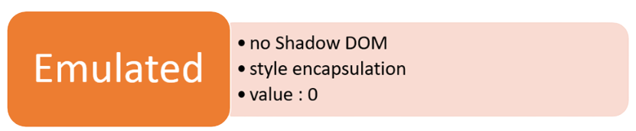


View encapsulation
What is view encapsulation?
What types of view encapsulation exist in Angular?

Slide 5
Angular styling mechanism (Emulated Encapsulation)
:host
:host-context
::ng-deep
What are :host, :host-context and ::ng-deep?

Slide 6
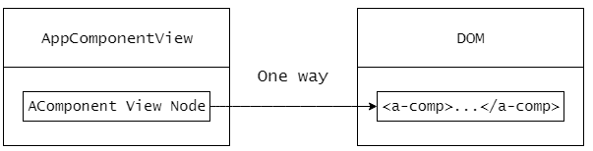
Angular views

Slide 7
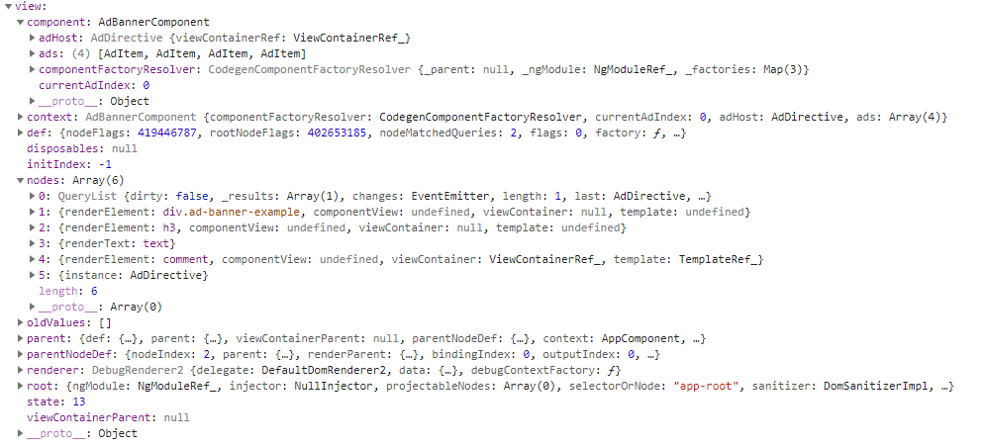
View structure

Slide 8
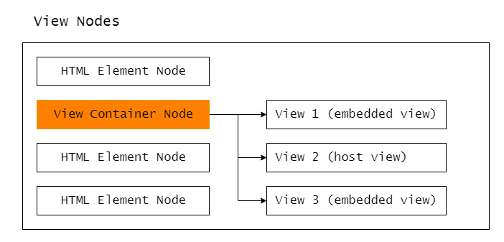
View types
Embedded
Host
What is ng-container?
What is template?

Slide 9
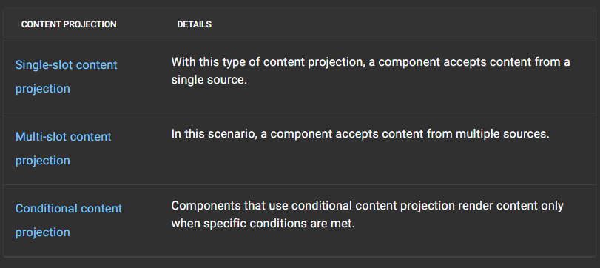
Content projection
What is content projection?
What is ng-content and its purpose?

